Slide 1

https://runtimeverification.com
runtime
verification
Brief Overview
Grigore Rosu
Founder, President and CEO
Professor of Computer Science, University of Illinois

Slide 2
Description and Mission
Runtime Verification, Inc. (RV): startup company aimed at bringing the best ideas and technology developed by the runtime verification community to the real world as mature and competitive products; licensed by the University of Illinois at Urbana-Champaign (UIUC), USA.
Mission: To offer the best possible solutions for reliable software development and analysis.

Slide 3
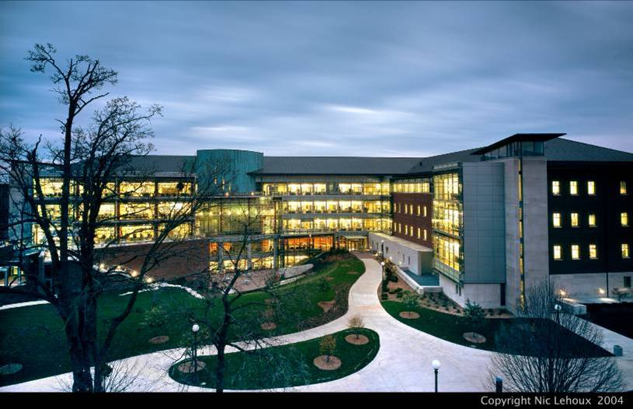
Computer Science @ UIUC
Ranked top-5 in the USA (US News)
RV technology is licensed by UIUC
RV employees are former UIUC students

Slide 4
Technology
Runtime verification is a new field aimed at verifying computing systems as they execute
  Good scalability, rigorous, no false alarms
We are leaders in the field
  Coined the term “runtime verification”
    As a NASA research scientist, back in 2001
  Founded the Runtime Verification conference (RV)
  100+ publications
  Raised $11.5M+ funding to develop technology

Slide 5
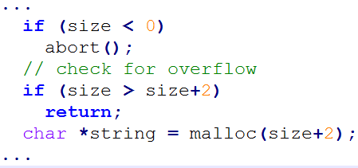
Runtime Verification Approach
Event Trace
Highly customized for property of interest
Highly customized for property of interest
Code
Build
Execute
Model
Bug 1
Bug2
…
Analyze
Advantages:
+ precise (no false alarms)
+ good scalability and rigor
+ recovery possible
Limitations:
- code must be executable
- less code coverage, hence
use with existing unit tests

Slide 6



Products
RV-Match is a semantics-based automatic debugger
for common and subtle C errors, and an automatic
dynamic checker for all types of ISO C11 undefinedness.
- C (mature); Java and JavaScript (prototypes)
RV-Predict is an automatic dynamic data-race detector
for Java, which is sound (no false positives) and maximal
(no other sound dynamic tool can find more races).
- Java (mature), C/C++ with interrupts (prototype)
RV-Monitor is a runtime monitoring tool that
allows for checking and enforcement of safety
properties over the execution of your software.
- Java (prototype), C/C++ (prototype)

Slide 7
Products
Coverage vs. Performance vs. Expressiveness
Big triangle: all
runtime behaviors
of your program
One path only;
0-100% overhead; complex properties
From one path to complete coverage / verification; any properties; may require user input
Maximal number of causally equivalent paths predicted from one path;
1-10²x overhead;
races, atomicity, deadlocks

Slide 8
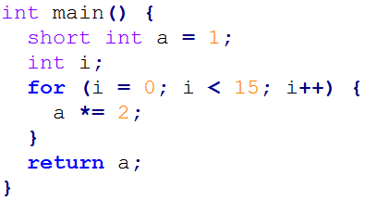
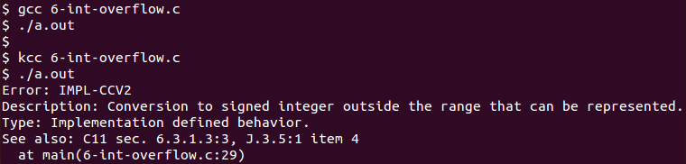
RV-Match
Code (6-int-overflow.c)
Get to market faster, increase code portability, and save on development and debugging with the most advanced and precise semantics-based bug finding tool. RV-Match gives you:
an automatic debugger for subtle bugs other tools can't find, with no false positives
seamless integration with unit tests, build infrastructure, and continuous integration
a platform for analyzing programs, boosting standards compliance and assurance
…
Conventional compilers do not detect problem
RV-Match’s kcc tool precisely detects and reports error, and points to ISO C11 standard

Slide 9
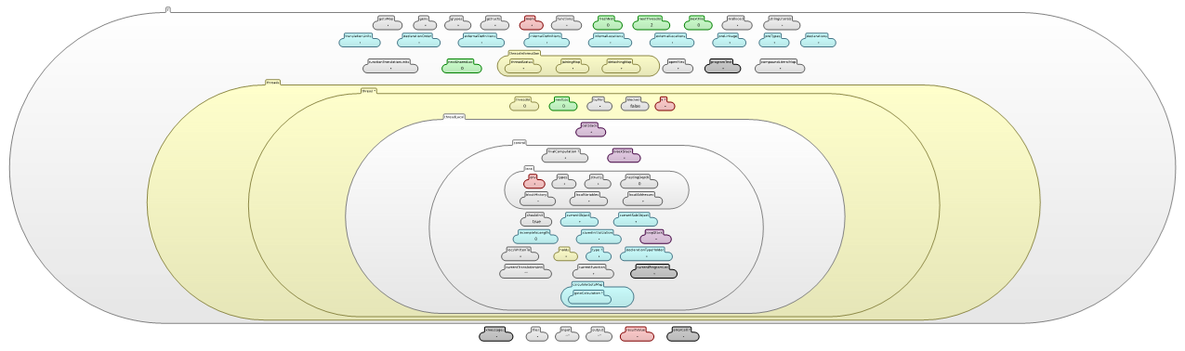
RV-Match Approach
Execute program within precise mathematical model of ISO C11
Build abstract program state model during execution
Analyze each event, performing consistency checks on state
Event Trace
Are all ISO C11
rules matched?
If “no” then error
Code
Build
Execute
Abstract State Model
Analyze
Heap
About 120 semantic state components

Slide 10


RV-Predict
Tomcat (OutputBuffer.java)
Automatically detect the rarest and most difficult data races in your Java code, saving on development effort with the most precise race finder available. RV-Predict gives you:
an automatic debugger for subtle Java data races with no false positives
seamless integration with unit tests, build infrastructure, and continuous integration
a maximal detection algorithm that finds more races than any sound dynamic tool
…
…
…
…
Conventional testing approaches do not detect the data-race
-------------------------------------------------------
T E S T S
-------------------------------------------------------
Results :
Tests run: 0, Failures: 0, Errors: 0, Skipped: 0
...
...
RV-Predict precisely detects the data-race, and reports the relevant stack-traces
Data race on field java.util.HashMap.$state:
{{{ Concurrent write in thread T83 (locks held: {Monitor@67298f15})
----> at org.apache.catalina.connector.OutputBuffer.clearEncoders(OutputBuffer.java:255)
...
Concurrent read in thread T61 (locks held: {})
----> at org.apache.catalina.connector.OutputBuffer.setConverter(OutputBuffer.java:604) ...

Slide 11
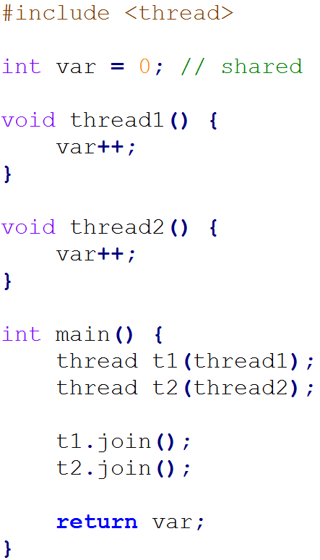
RV-Predict Approach
Instrument program to emit event trace when executed
Give every observed event an order variable
Encode event causal ordering and data race as constraints
Solve constraints with SMT solver
Is ϕ satisfiable?
(we use Z3 solver)
If “yes” then data race
Code
Event Trace
Execute
Build
Model
Analyze
Causal dependence as
mathematical formula ϕ

Slide 12



Next Steps
For more details see Technology and Products
Checkout our products
  First read documentation, see if tool fits your need
    Illustrated with lots of examples
  Then download and evaluate them
    90 day fully-featured evaluation versions available
Contact us with any questions

